Slide 1
Welcome
- Applied Physics

Slide 2
Team Members:
02
03
04
05
01
M. Zahid
Muhammad Dewan
Syeda Hanan
Fiza Tariq
Mishma Ashraf

Slide 3
Intrinsic and Extrinsic
Semi-conductors
Presented to: Miss Ayesha Malik

Slide 4
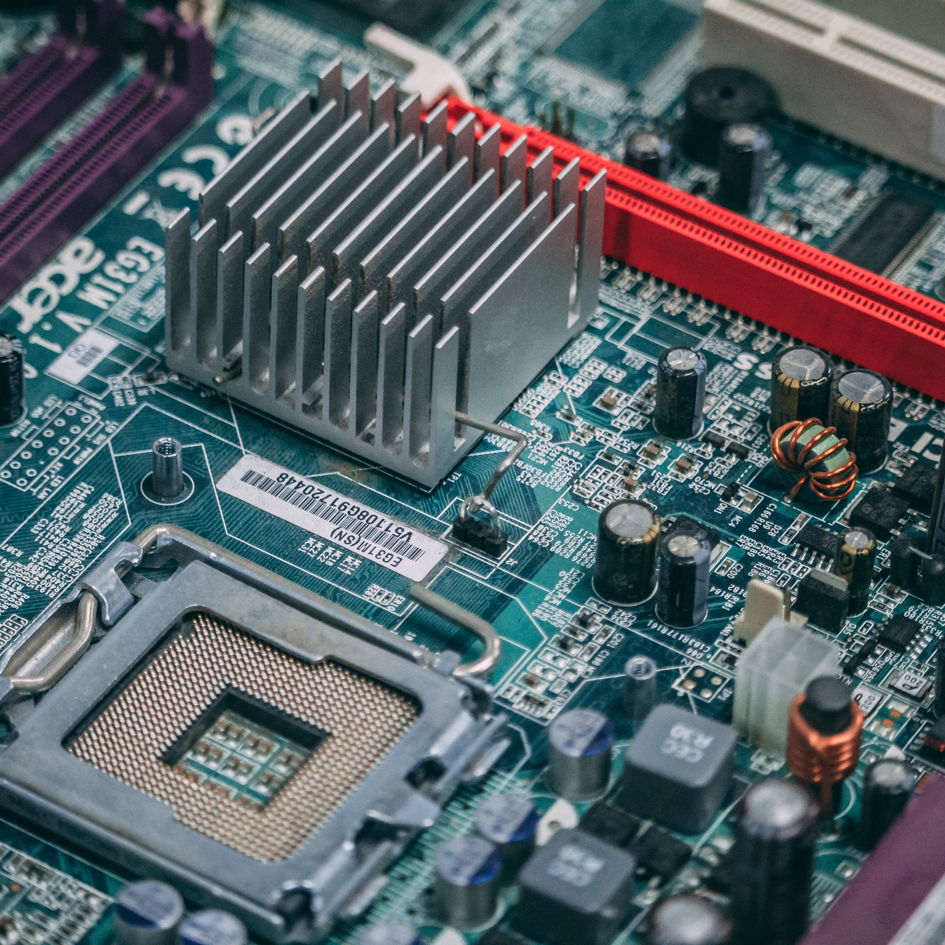
Semi-Conductors
A semi-conductor is a substance that can conduct electricity under certain conditions but not others. They have properties that sit between conductors and insulators. They are widely used in computers and other electric devices due to their unique electrical properties.
https://en.wikipedia.org/wiki/Semiconductor

Slide 5
01
Types
Intrinsic semi-conductors
Extrinsic semi-conductors
https://byjus.com/jee/semiconductors/

Slide 6
Definition of concepts
Intrinsic
Extrinsic
A pure form of semi-conductor with no impurities is called an Intrinsic Semi-Conductor
An impure form of semi-conductor which contains various impurities is called an Extrinsic Semi-Conductor

Slide 7
Features of Intrinsic Semi-Conductors
Limited Conductivity
Temperature Dependent
Particle Density
Intrinsic semiconductors have relatively low conductivity compared to metals.
They behave as an insulator at 0K and as a conductor at higher temperature
The density of electrons in Intrinsic semi-conductors is equal to the density of holes
https://byjus.com/physics/intrinsic-semiconductors/

Slide 8

Molecular Diagram
Si
Si
Si
Si
Si
Si
Si
Si
Free Electrons
Holes
Si
Si
Si
Si
Silicon Molecule
Si
Si
Si
Si
Si

Slide 9
Features of Extrinsic Semi-Conductors
Doping
Classification
Impurities
It is the method of adding an impurity to a pure substance to alter its electrical properties and create an extrinsic semi-conductor
They are divided into two types:
n-type (-ve charge)
p-type (+ve charge)
They may contain a trivalent or pentavalent impurity in them.
Example: Nitrogen, Arsenic, Phosphorus, Aluminum etc
https://byjus.com/physics/extrinsic-semiconductors/

Slide 10
n-type
p-type
These semi-conductors contain electron donor impurities.
The majority charge carriers are electrons.
They have higher electron concentration and lower holes concentration.
Pentavalent impurities are added to form n-type conductors.
Electrons move towards the conduction band.
Examples: Arsenic, Antimony, Phosphorus etc.
These semi-conductors contain electron acceptor impurities.
The majority charge carriers are holes.
They have lower electron concentration and higher holes concentration.
Trivalent impurities are added to form p-type conductors.
Holes move towards the valance band.
Example: Boron, Aluminum, Gallium etc.
https://www.tutorialspoint.com/difference-between-p-type-and-n-type-semiconductor

Slide 11
N-type
Sb
Si
Sb
Si
Si
Sb
Si
Sb
Sb
Antimony
Antimony is typically used as a donor dopant in silicon, introducing extra electrons into the crystal lattice. This leads to the creation of an n-type semiconductor, where the majority charge carriers are electrons.
Sb
Si
Sb
Si
Si
Sb
Si
Sb

Slide 12
P-type
B
Si
B
Si
Si
B
Si
B
B
Boron
In the case of Boron, it is typically used as an acceptor dopant, meaning it creates "holes" in the crystal lattice of silicon, leading to the formation of a p-type semiconductor.
B
Si
B
Si
Si
B
Si
B

Slide 13
Energy Band Theory
In case of solids, the energy level of outermost electrons is affected by the nearby atoms. When two atoms are brought closer to each other, then the nucleus of one atom produces an attractive force on the outermost electrons of the other atom. This causes the energy level of electrons to be changed to higher or lower level than its orignal value. Thus, electrons in the same orbit posseses different energy levels. The grouping of these different energy levels is called energy band
Classification of Energy Bands
Valance Band
The valance electrons contain a series of energy levels and form an energy band called the valance band. The valance band has the highest occupied energy
Conduction Band
Sometimes, the valance electron may detach from the outermost orbit and become a free electron. These free electrons conduct current and are thus known as conduction electrons. They form the conduction band and have the lowest occupied energy
https://byjus.com/physics/what-are-energy-bands/

Slide 14
Conduction Band and Valance Band
The gap between conduction and valance band is called as forbidden energy gap. The gap does not have any energy and electrons does not stay in this band. If the gap is high, then valance electrons are tightly bound to the nucleus. This gap is very low in conductors and very high in insulators
Conduction Band
Fermi Level
Forbidden Gap
Band Energy
Valance Band

Slide 15
02
Advantages
Disadvantages
https://www.ecstuff4u.com/2019/10/advantage-disadvantage-semiconductor-devices.html

Slide 16
Advantages
Compact
Power Saving
Lifetime Use
They are very small in size so the circuits involving them are very compact and portable
They require a very low voltage to operate and hence the power consumption is very low
The semi-conductor devices can be used for a very long time
Shock Proof
Cheaper
Immediate Use
Semi-conductor devices are usually shockproof and safe
They are very cheap to produce as compared to vacuum tubes
No heating is required so these devices are immediately set into operation

Slide 17
Disadvantages
Production
Noise
Production of high quality semiconductors require a complex process and skilled workers
The noise level is too high compared to vacuum tubes.
Radiation
Performance
At high frequency, they have poor performance
They are radiation sensitive which can affect their performance

Slide 18

03
Applications
of semi-conductors

Slide 19
Applications
Transistors
Transistors use silicon semi-conductors to control the flow of electrical signals throughout the circuit.
Fibre optics technology is the future of communication technology. Many communication devices like diodes, LEDs, detectors etc are made on basis of semiconductor technology
Communication
Semi-Conductors play important role in the functioning of diodes. They are use in rectification, LEDs, Voltage Diodes, photodiodes etc.
Diodes
https://scholar.google.com/scholar?hl=en&as_sdt=0%2C5&q=applications+of+semiconductors&oq=Applications+of+semi https://www.jetir.org/papers/JETIRFJ06046.pdf

Slide 20
Applications
semiconductors are at the heart of advanced medical technology. They enable precise diagnostics, imaging, and life-saving interventions. MRI, X-ray machines, monitoring devices etc includes semiconductor technology
Healthcare
Solar Cells
They are used in solar cells to convert sunlight into electricity and in power inverters to manage the flow of electrical energy
Semi-conductors are used in daily home appliances in refrigerators, TVs, Air Conditioners, etc. They are used in optimizing energy consumption, in sensors and also in adding smart functionality
Appliances

Slide 21
Applications
Semi-conductors based microprocessors are used in computers, laptops, gaming consoles, phones and other devices. They are necessary for the proper functioning of these devices
Micro- processors
Semi-Conductors have helped in enhancing safety, efficiency, and entertainment systems. They are integral to engine control units, airbags, navigation systems, and entertainment consoles.
Transportation
All electronic devices including Computers, appliances, phones, TVs, radios, refrigerators and many more require semi-conductors to work. Thus, semi-conductors have become a major need for today’s world
Electronics

Slide 22
04
Difference
Between
Intrinsic semi-conductors Extrinsic semi-conductors
https://www.javatpoint.com/difference-between-intrinsic-and-extrinsic-semiconductor

Slide 23
Intrinsic
Extrinsic
The semi-conductor in its pure form is called Intrinsic semi-conductor
There is no furthur classification of Intrinsic semi-conductors
These conductors do not have any impurities and have low operating temperature
The electrical conductivity of Intrinsic semi-conductors is very low
The number of electrons is equal to the number of holes
There is no doping or addition of impurities in them
Examples: The crystalline forms of pure Silicon and Germanium.
The semi-conductor which contains impurities is said to be Extrinsic
They are furthur classified as n-type and p-type extrinsic semi-conductors
They have high operating temperature and also depends upon various factors of the added impurity
The electrical conductivity of Extrinsic semi-conductors is very high
The number of electrons and holes is never equal to each other
Impurities are added in them using the method of Doping
Example: Pure form of Silicon and Germanium doped with chemical impurities like B,Sb,Al etc

Slide 24
Any Questions?

Slide 25
Thank You
For staying with us

